Slide 2
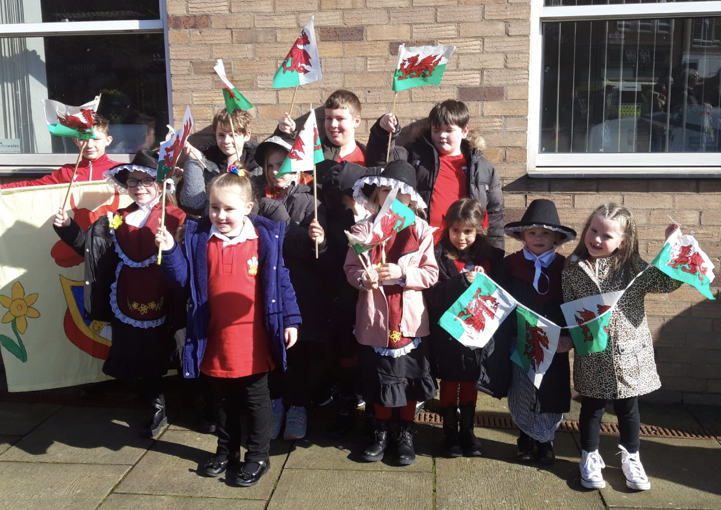
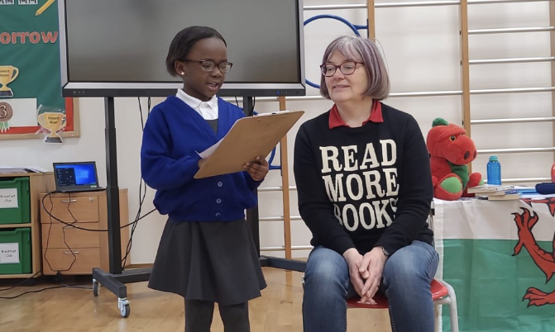
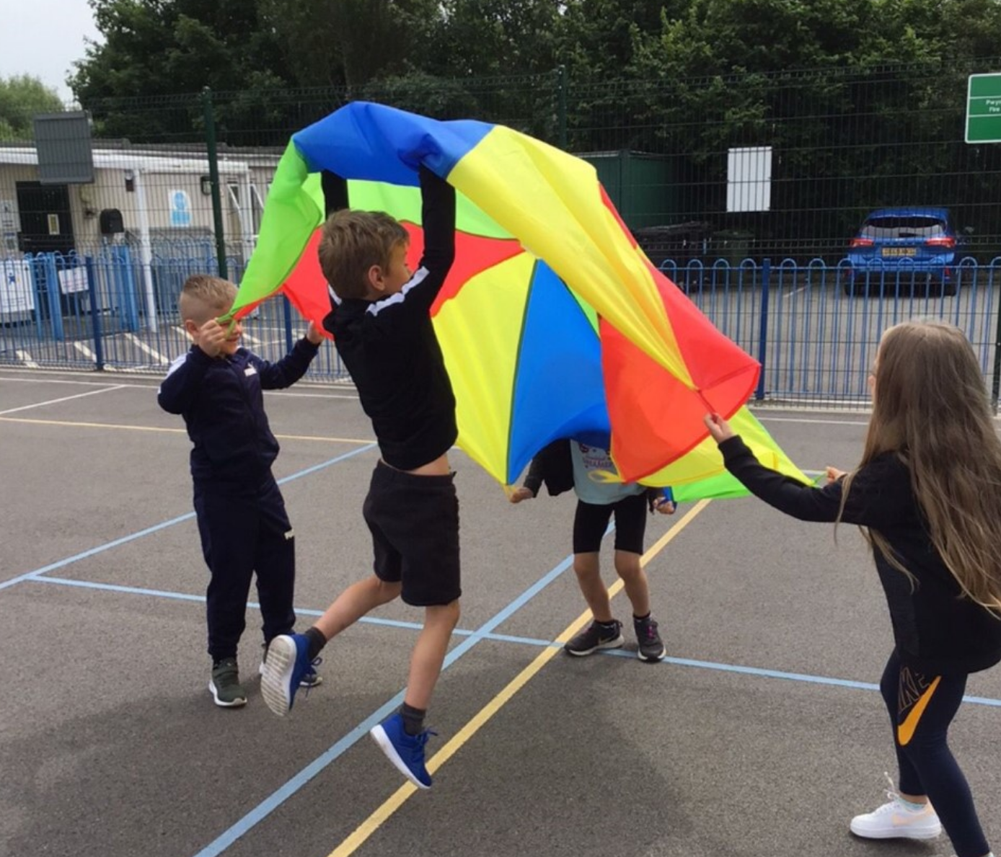
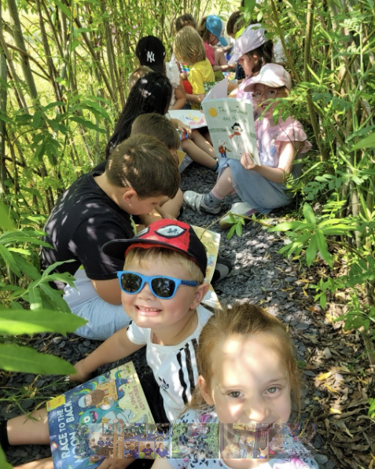
Gwenfro CP School- Context
Gwenfro CP School is a primary school situated in the Caia Park area of Wrexham. We provide education for approximately 327 learners from 3-11 year old.
At Gwenfro, we teach through the medium of English. We are extremely proud of our welsh heritage and culture and strive to develop a strong welsh ethos throughout our school. We hold a biannual Eisteddfod, celebrate Dydd Gwyl Dewi Sant and Owain Glyndwr day. We actively encourage our learners to use their welsh language skills.
At Gwenfro, we have 2 Resource Provision classes, Dosbarth Penrhyn (FP) and Dosbarth Rhuthun (KS 2). These classes provide learning opportunities for pupils across the LA who are identified as having Additional Learning Needs. These range from emotional, behavioural issues, those on the autistic spectrum and a range of medical needs.
Well-Being is at the core of our ethos and approach at Gwenfro and we pride ourselves on being safe space for learners to achieve and grow. Our ethos is one of support and nurture.
The 3 year average for pupils eligible for Free School Meals is 57%. We have identified 8% of pupils as having Additional Learning Needs.
We currently have approximately 16.7% of pupils who speak English as an Additional Language.

Slide 3
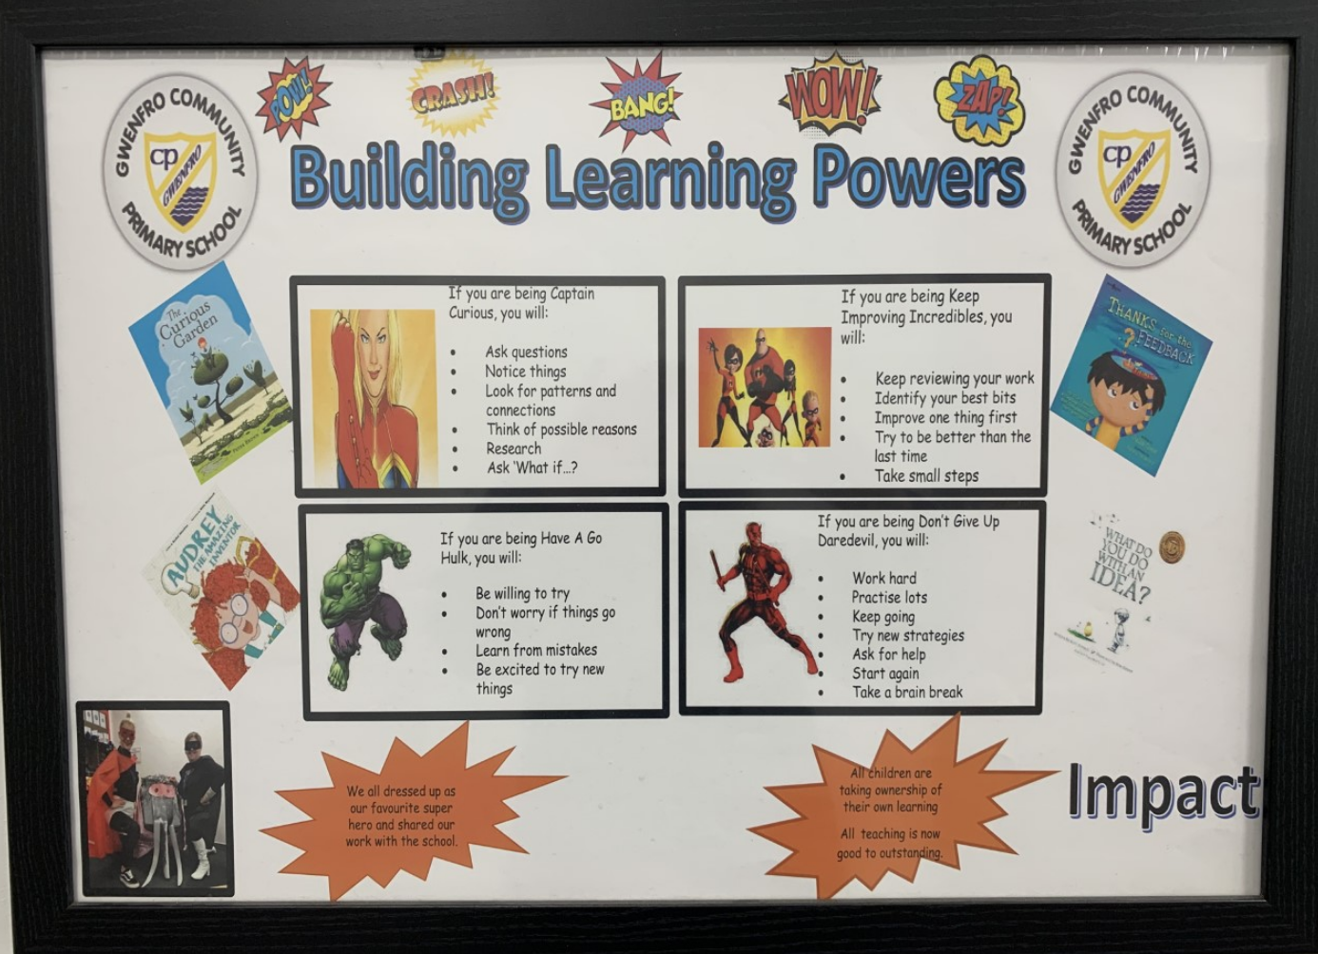
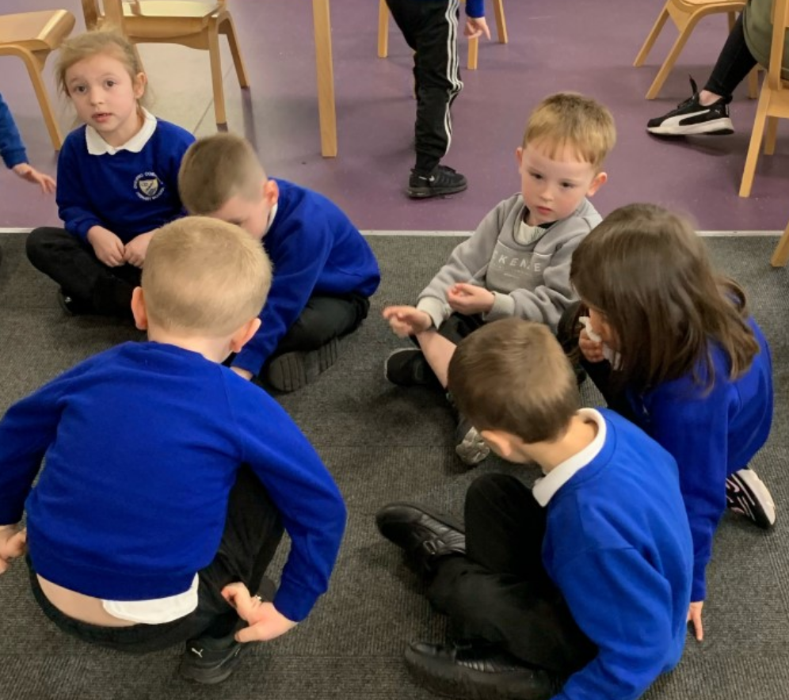
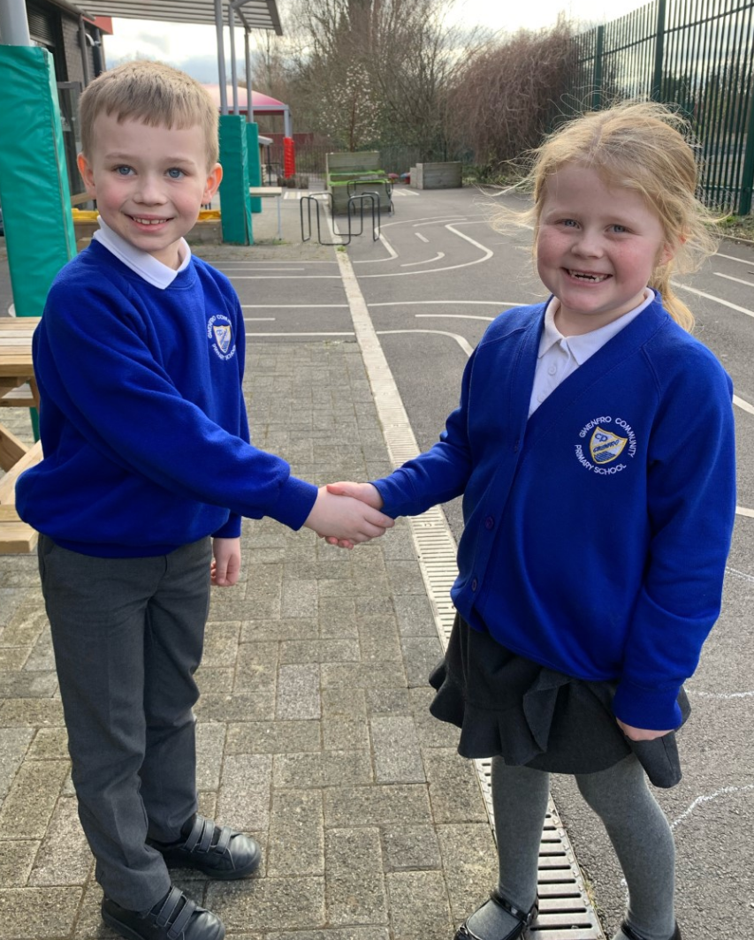
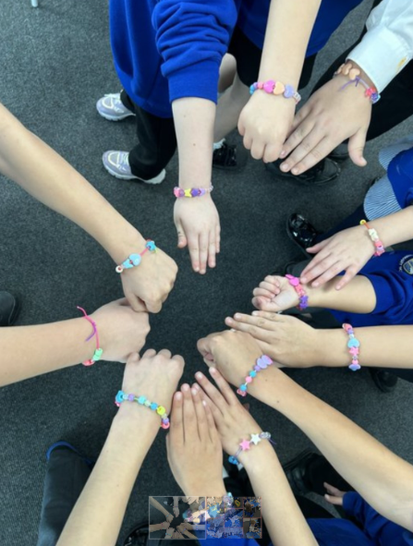
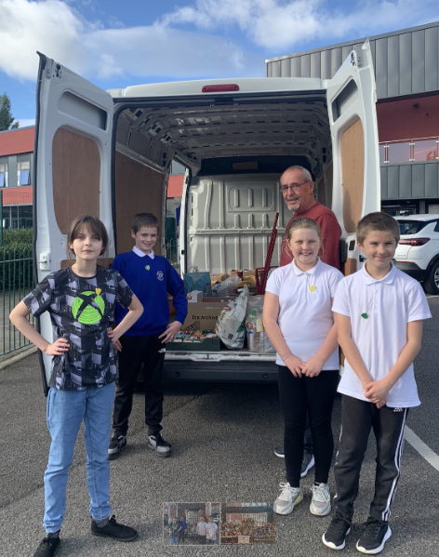
Our Values
RELATIONSHIPS
We have positive relationships based on mutual respect and trust. We respect
the views
of everyone
INSPIRATION
We share ideas, support each other, and embrace
challenge
RESILIENCE
We use our Learning Powers, challenge ourselves, persevere, learn from our mistakes and problem
solve
KINDNESS
We care about each other and show this through out actions and words.
We consider the feelings of others
COMMUNITY
We work together as active members of our community
SAFETY
We keep ourselves and each other safe. We show empathy and listen
INNOVATION
We are creative learners and take risks. We use our thinking skills to develop and evaluate ideas

Slide 4
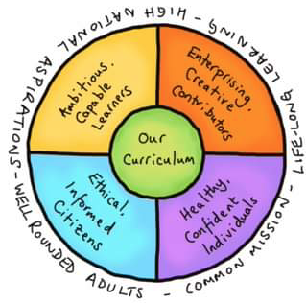
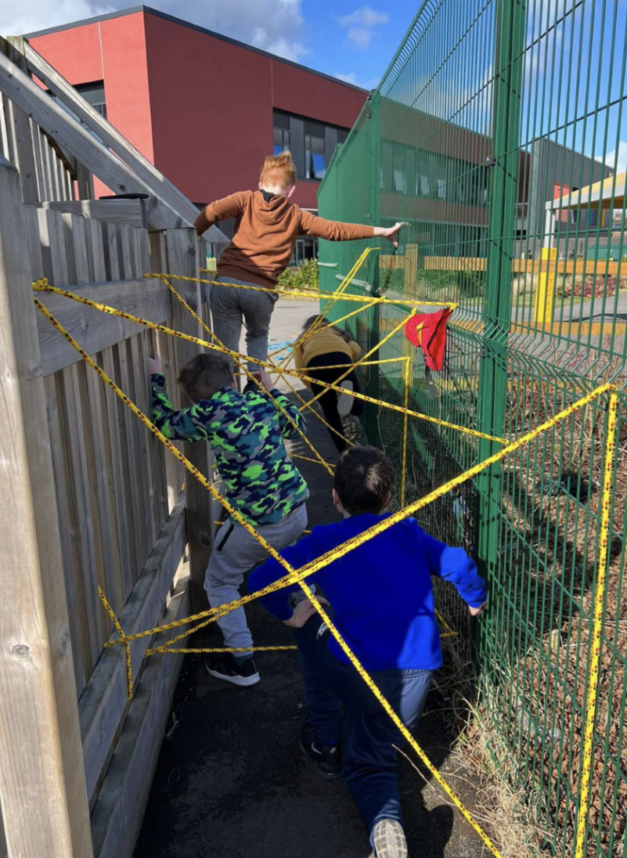
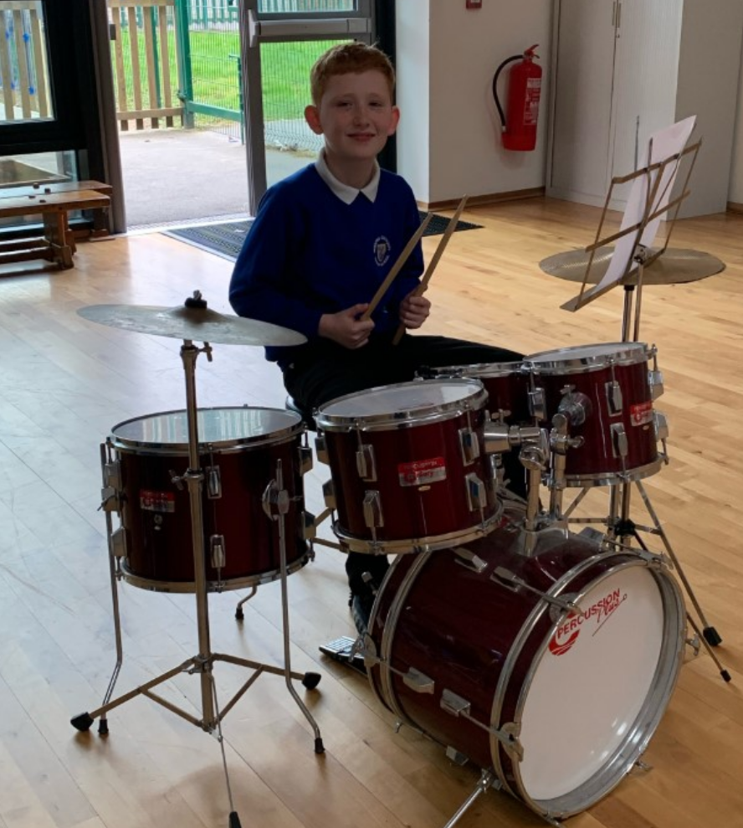
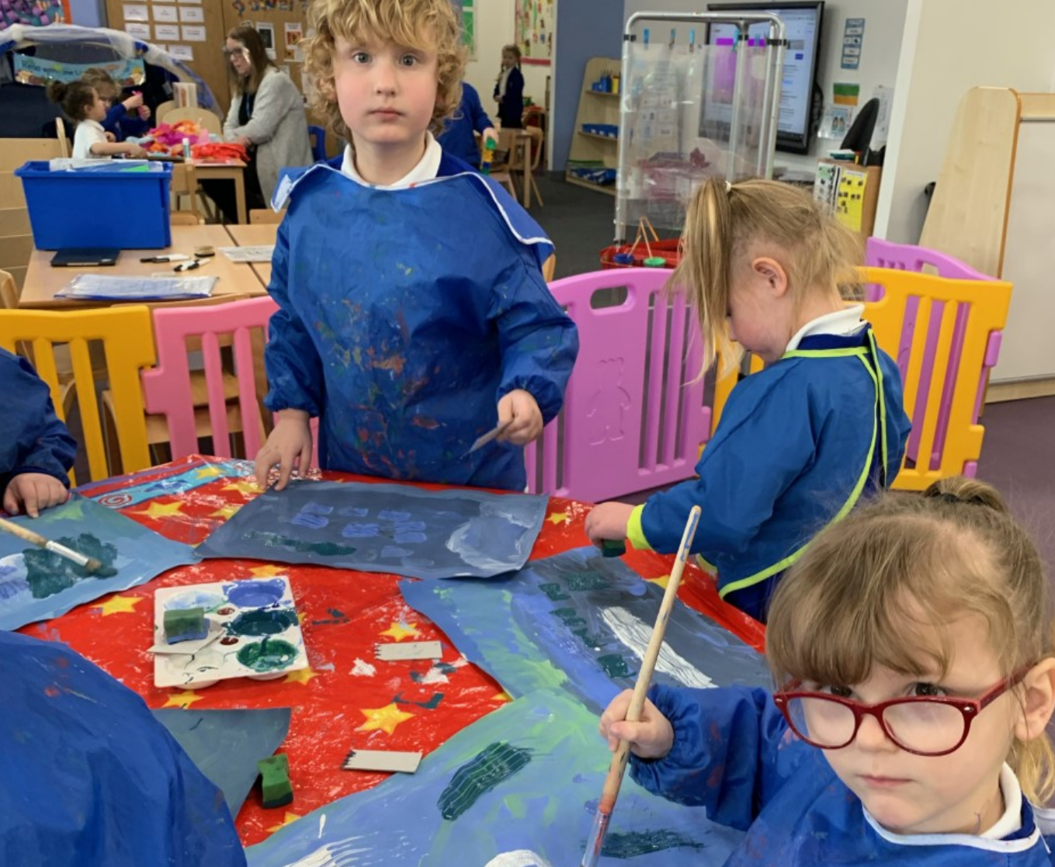
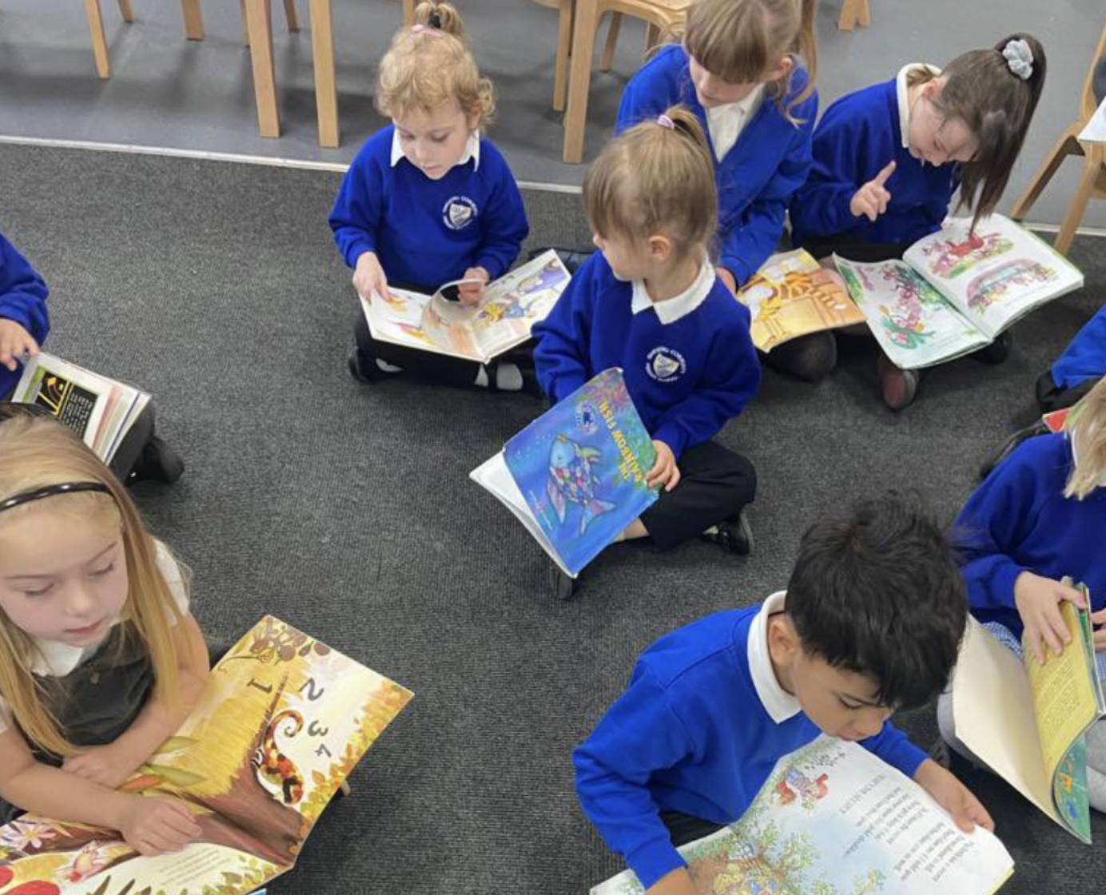
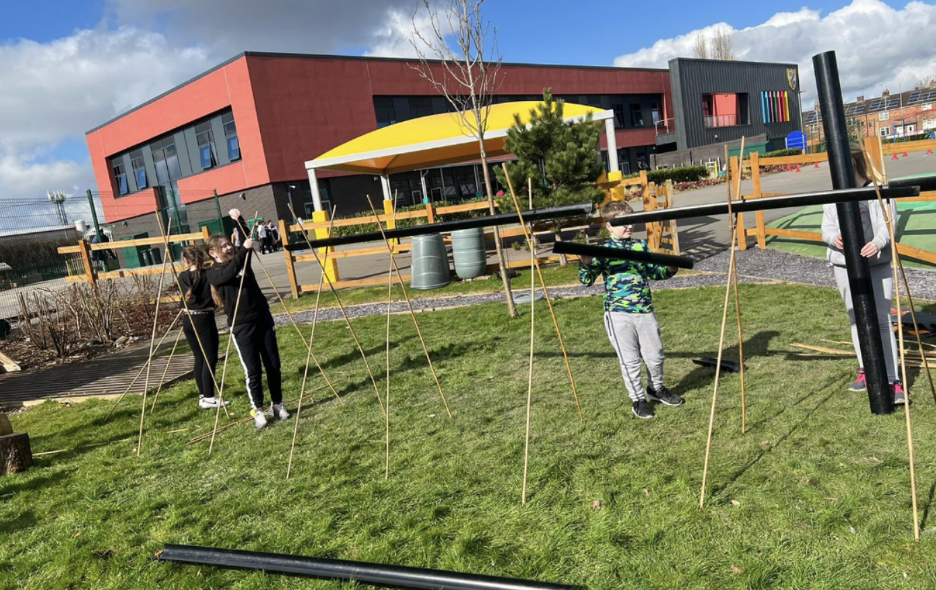
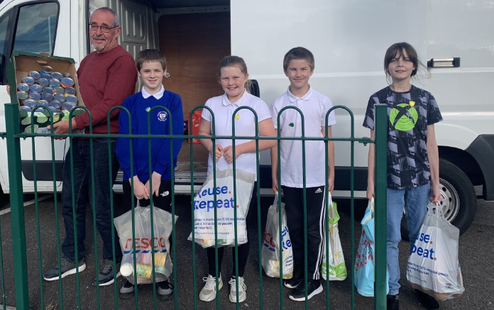
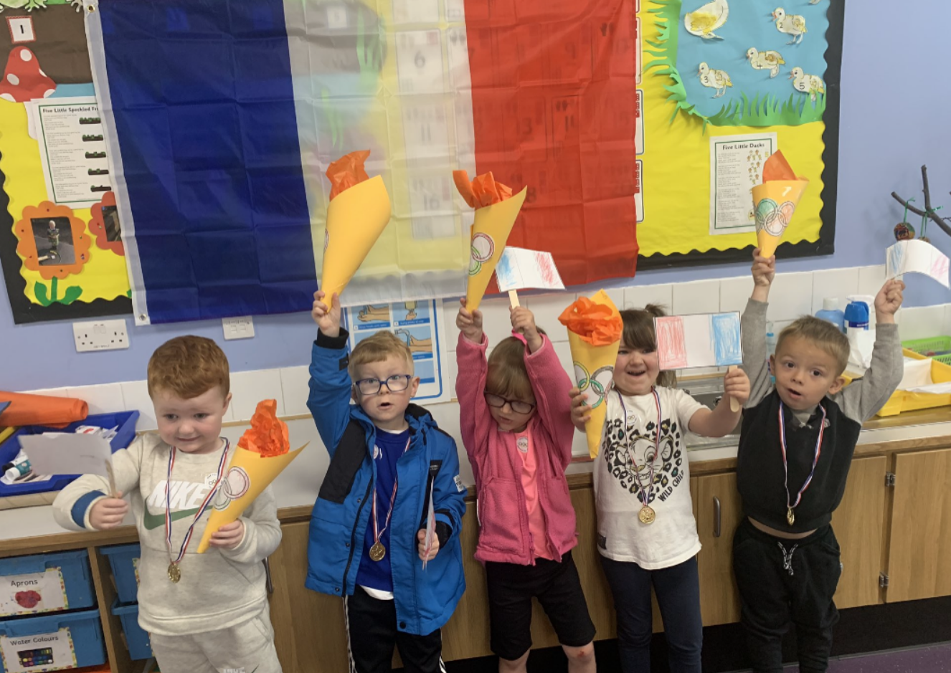
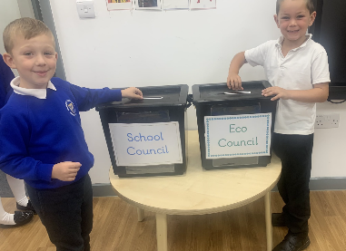
4 Purposes
The 4 purposes of Curriculum for Wales underpin all aspects of curriculum design, planning,
teaching and learning experiences at Gwenfro.
Ambitious Capable Learners…. | Enterprising, creative contributors….
Set high standards and challenge themselves Develop knowledge and skills and apply them in different ways Ask questions and solve problems Communicate their learning in different ways Use their digital learning creatively to communicate, find and analyse information Use mathematics and numeracy skills Research and evaluate | Think creatively Apply their knowledge and skills to create ideas Take risks Problem solve Work collaboratively Express ideas and emotions in different ways Use their energy and skills for the benefit of others
Healthy, Confident Learners…. | Ethical, Informed Citizens….
Are building their mental and emotional well-being Know about the impact of physical health Know how to keep themselves safe Have the ability to face and overcome challenges Have core values and are establishing their spiritual and ethical beliefs Form positive relationships based on mutual trust and respect Are developing the skills and independence to manage everyday life | Understand the impact of their actions Find, evaluate and use evidence to inform their views Respect the needs and rights of others as members of a diverse society Know about their own culture and community as well as the world around them, now and in the past Understand their role in ensuring the sustainability of the planet Are committed citizens of the world

Slide 5
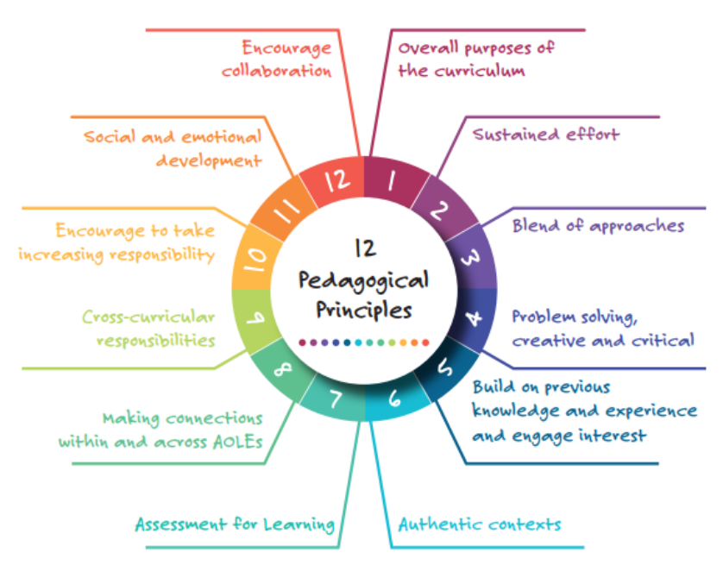
Pedagogical Principles
The 12 pedagogical principles of Curriculum for Wales underpin effective teaching and learning experiences at Gwenfro.
The staff at Gwenfro have invested in developing effective pedagogy in line with local and national developments.
Staff professional development is always linked to the continued improvement of effective pedagogy.

Slide 6
Mandatory Elements
CROSS CURRICULAR SKILLS
WELSH
There are some elements of the new Curriculum for Wales which are mandatory, which means that all schools must include them as part of the curriculum design and content. Please click on the links:
MANDATORY ELEMENTS
RVE
ENGLISH
RSE

Slide 7
RELATIONSHIPS AND SEXUALITY EDUCATION
RSE is a mandatory element of the Curriculum for Wales Framework and a curriculum must accord with the RSE Code. This means schools and settings must include the learning set out in the Code.
At Gwenfro, we aim to use the RSE code to inform our curriculum design process, ensuring that this is appropriately planned for according to the phase and development of our pupils.
We aim to create a safe environment based on mutual trust and respect that enables our learners to express their own views and opinions. We may include learning about current tensions, disagreements or debates within society, and different perspectives within faiths on issues. Developing this pluralism is important in ensuring our learners develop as informed citizens who are aware of and sensitive to a range of different opinions, values and beliefs.
When approaching RSE, we aim to draw on partnerships with a range of people and organisations; businesses, communities, public sector charitable and voluntary organisations and others who work in partnership with our school. A good understanding of learners’ views, emerging values and backgrounds is central to developing pluralism. Positive relationships with wider communities can help to create a constructive context for exploring aspects and tensions in a sensitive way.
Children Rights under the UNCRC are central to all of the Welsh Government’s work, in line with its commitments and duty to have regard to the UNCRC in all that it does. We aim to effectively link learning where appropriate.

Slide 8
RELIGION VALUES AND ETHICS
RVE is a mandatory element of the humanities curriculum. This is built on a series of big ideas where pupils are encouraged to engage critically with a broad range of religions and non-religious, philosophical convictions.
As a Community school, our curriculum for teaching and learning encompassing RVE, will be designed having regard to the agreed syllabus. (The “agreed syllabus” in the context of the RVE is adopted by the local authority). The Act requires this RVE provision to be implemented for all pupils.

Slide 9
CROSS CURRICULAR SKILLS
The mandatory cross-curricular skills of literacy, numeracy and digital competence are essential for learners to be able to access knowledge. They enable learners to access the breadth of our curriculum and the wealth of opportunities we offers, equipping them with the lifelong skills to realise the four purposes. These are skills that can be transferred to the world of work, enabling learners to adapt and thrive in the modern world.
Our aim is to develop a curriculum which enables our learners to develop competence and capability in these skills and, where there are opportunities, to extend and apply them across all Areas. Developing these skills is therefore a consideration for all practitioners.
Learners must be given opportunities across the curriculum to:
develop listening, reading, speaking and writing skills
be able to use numbers and solve problems in real-life situations
be confident users of a range of technologies to help them function and communicate effectively and make sense of the world
Rather than planning for these skills separately, the whole school should be involved and engaged in order to embed these skills across the curriculum. It will, therefore, be the responsibility of all practitioners across all Areas to develop and reinforce these skills across the curriculum, and not just for specialist practitioners in the fields of mathematics, language and computing.

Slide 10
ENGLISH
Languages connect us with people, places and communities. By teaching English as our first language and giving opportunities for children to speak Welsh as a second language, we believe that we are equipping our children to be learners and citizens of a bilingual Wales.
Meaningful language learning experiences go hand in hand with learning about our own cultural identity as well as the cultural identities of others. Engagement with this Area can therefore foster in learners, pride in their sense of identity and belonging to Wales as well as the wider world.
English and Welsh is taught from the age of 3.

Slide 11
WELSH
Languages connect us with people, places and communities. By teaching English as our first language and giving opportunities for children to speak Welsh as a second language, we believe that we are equipping our children to be learners and citizens of a bilingual Wales.
Meaningful language learning experiences go hand in hand with learning about our own cultural identity as well as the cultural identities of others. Engagement with this Area can therefore foster in learners, pride in their sense of identity and belonging to Wales as well as the wider world.
English and Welsh is taught from the age of 3.

Slide 12
Designing our Curriculum
Step 1 Vision & Purpose We began by considering our core values, the needs of our pupils, context and school, and pedagogical approach. This supported our vision for the new curriculum at Gwenfro.
Step 2 Provision and Enhancement Through continued professional development of staff, expectations with regard to quality teaching and learning have been established.
Step 3 Curriculum Content We have unpacked the What Matter’s Statements and taken the voice of all stakeholders to begin to design our curriculum content. We focus on skills, knowledge and experience to determine breadth and balance in what we learn about.
Step 4 Planning We plan holistically to realise the 4 purposes. We plan a range of learning opportunities to deveop pupils’ skills, and knowledge to enrich their learning journey.
Step 5 Progression & Assessment We use a range of assessment strategies to monitor and track the progression of our pupils. We have a clear vision for how this will be developed to ensure that pupil progress through Curriculum for Wales Progression Steps is tracked.
Step 6 Evaluation It is important that we continue to review and evaluate our approaches to the new curriculum and the impact this is having on the progress of our pupils. We always aim to access professional learning with the view to adapt to the need of our school.

Slide 13
Expectations/Non-Negotiables
At Gwenfro, we have a set of expectations or ‘non-negotiables’ which supports our approach towards the curriculum and enriches the learning journey of our pupils.
Nurture- We work closely with our pupils and their families to foster positive working relationships to support all aspects of well-being. We strive to develop core values of kindness, empathy and resilience. Physical and mental well-being is at the core of our approach to develop a readiness to learn and thrive.
Positive Growth Mindset- We teach our pupils to have ambition and aspirations for the future. We use effective learning strategies, Learning Powers, feedback and observation to develop pupils’ growth mind-set and a belief that through dedication and hard work, they will achieve.
Inclusion- This is at the core of our ethos at Gwenfro and we ensure equability for all. We recognize that each child is on a personal journey and we ensure that their needs are support. Integration is an important part of our inclusive ethos, developing a sense of belonging and Cynefin.
Purposeful, Authentic, Creative Learning- We are designing a curriculum which is relatable and relevant to the demands of todays world, preparing learners for life as active citizen. At Gwenfro, we aim to provide creative, purposeful learning experiences which relate to real life, link to our local community and charitable organisations and develop Curriculum Cymreig.

Slide 14
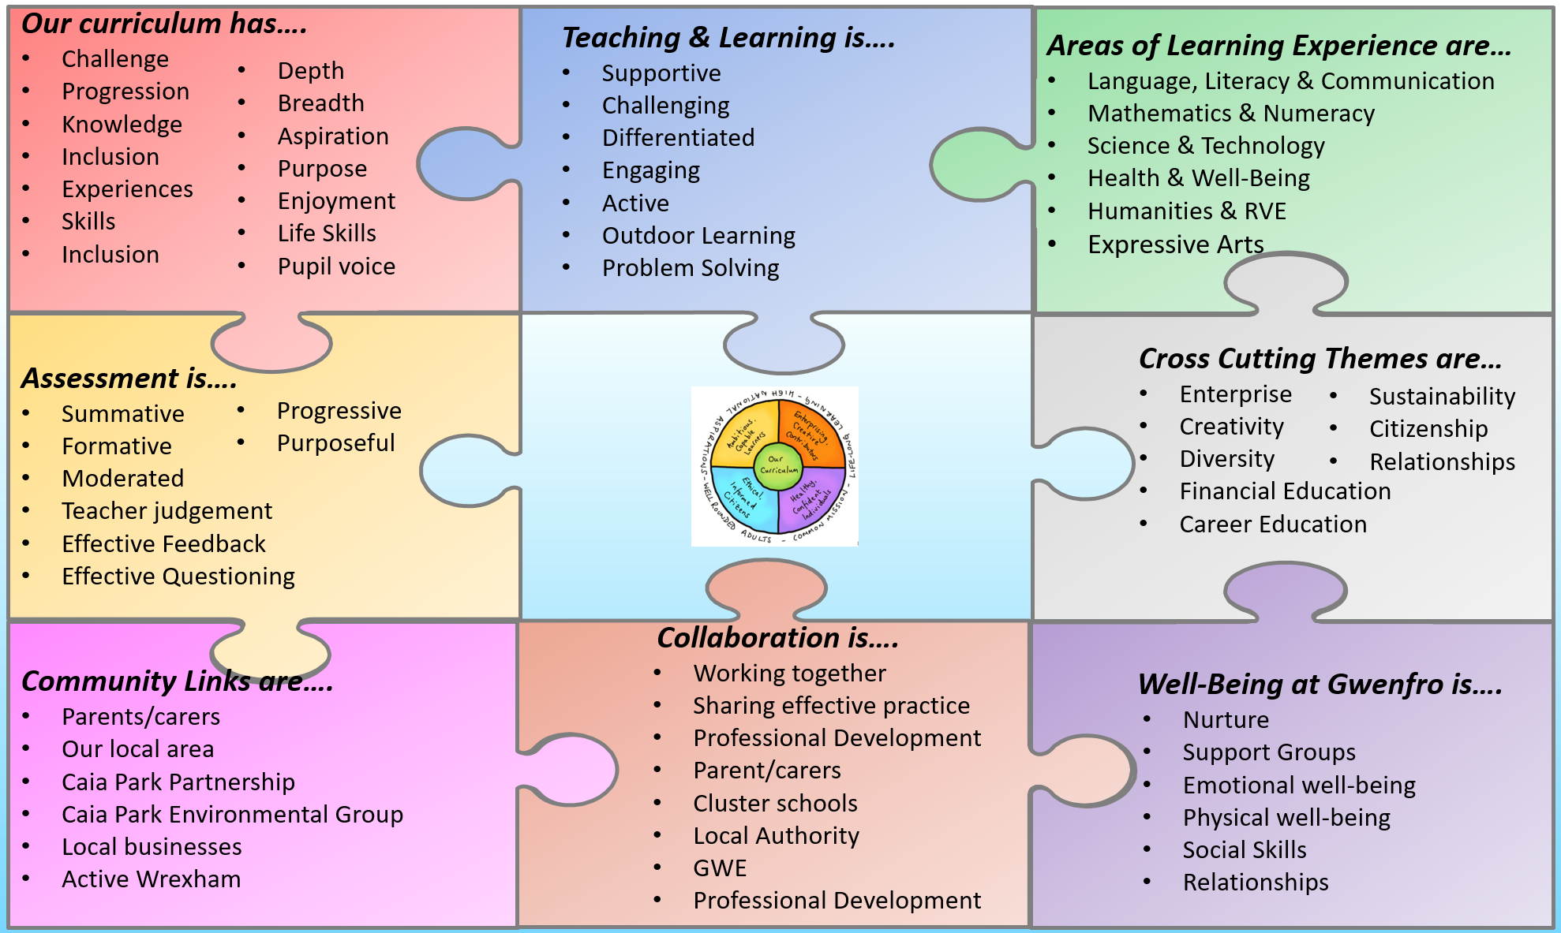
Curriculum Rationale

Slide 15
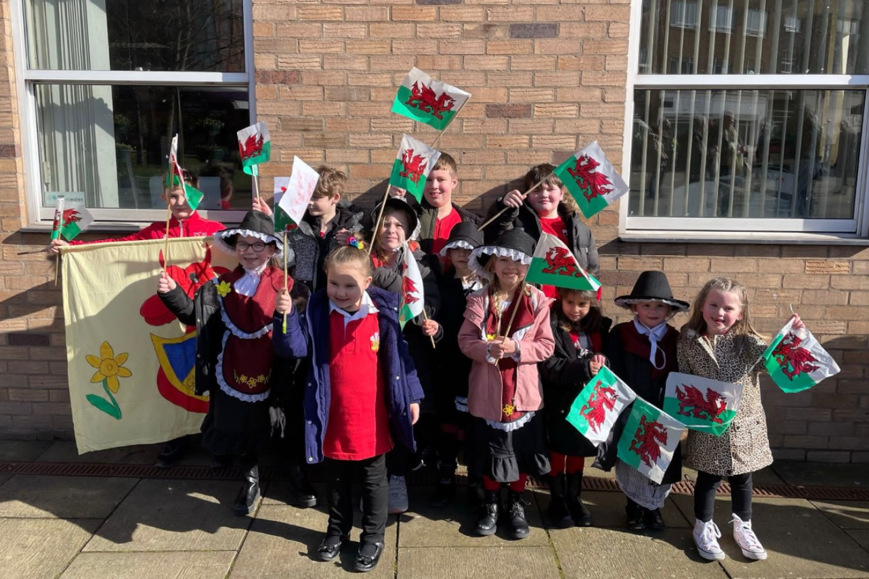
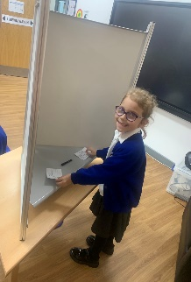
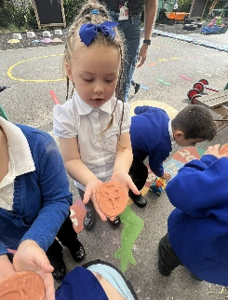
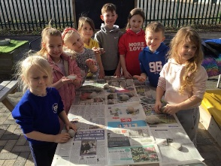
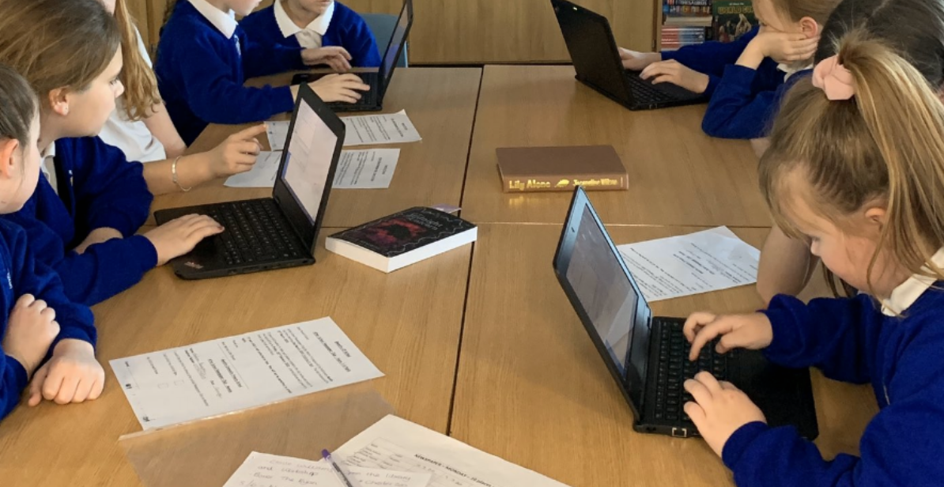
Our curriculum…
Our curriculum at Gwenfro is accessible to all. It encompasses the aspiration to develop our pupils as citizens of the world.
Gwenfro is a learning organisation and the professional learning of staff is key to developing a love of learning through enjoyable, purposeful opportunities which help to develop learners towards the 4 Purposes.
We ensure that our curriculum is based on the development of knowledge
and skills through purposeful and challenging learning experiences which are inclusive for all.
We actively encourage pupil influence into our curriculum planning and always try and relate this to real life experiences.
Throughout the process of curriculum design, we use the descriptors of learning to plan a range of broad learning experiences which are child centred, relevent and enjoyable. We support our learners to engage with the descriptors of learning with increasing depth and challenge as they progress over time, providing opportunities to reinforce and apply their learning through a range of contexts.
This process supports the development of a high level curriculum at Gwenfro.
At Gwenfro, we ensure that our welsh heritage and culture is celebrated.
We strive to develop pupils’ welsh language skills at every opportunity.
Digital Competence
is threaded into all
areas of learning.
We always aim to develop pupils’ skills in a progressive and meaningful way.
Our aim at Gwenfro is for our pupils to become active, responsible citizens, with effective basic skills. We always aim to develop and a strong sense of aspiration and their own sense of Cynefin.

Slide 16
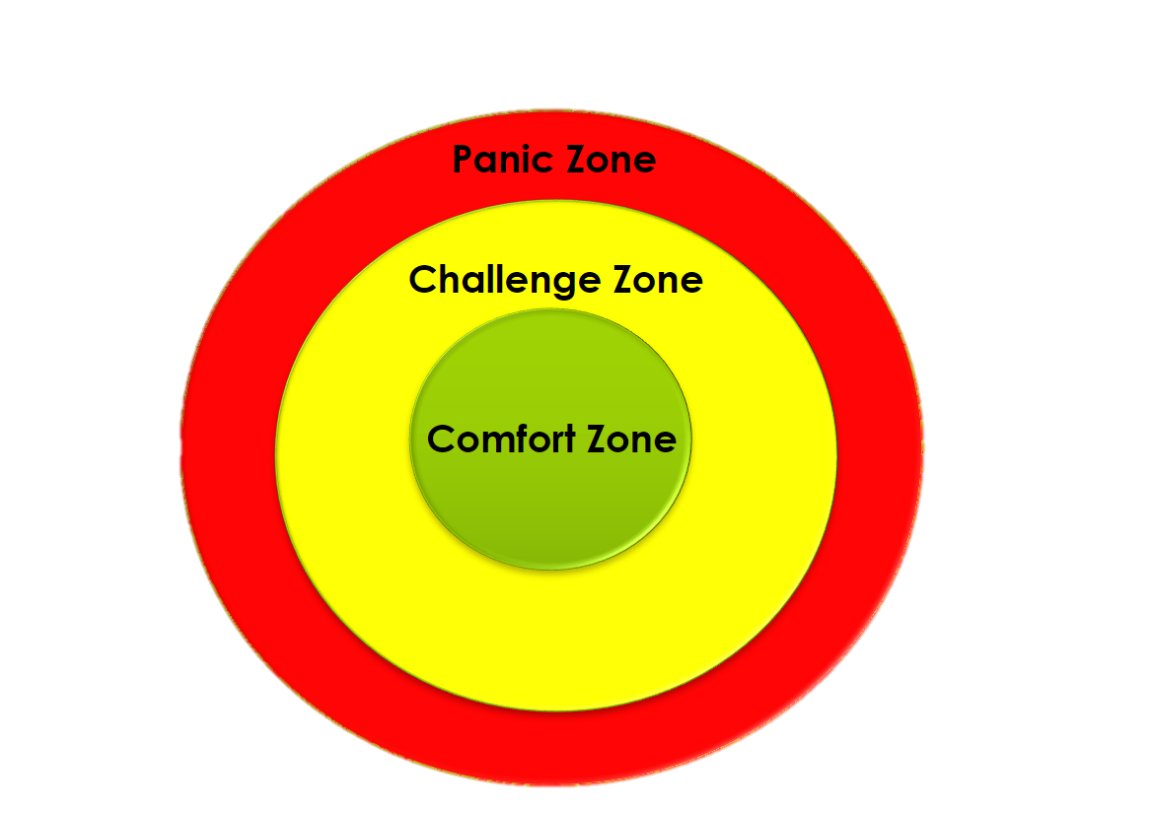
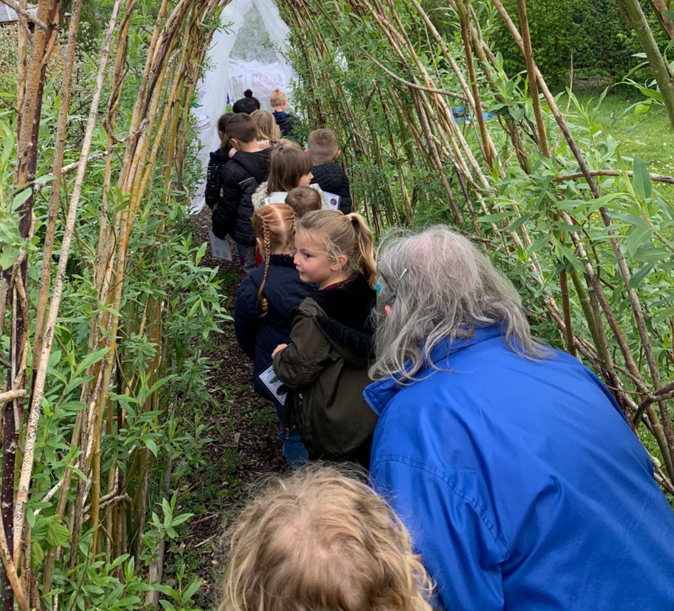
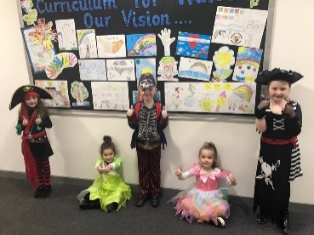
Teaching & Learning….
Teaching and Learning at Gwenfro is creative and purposeful. It uses the 12 pedagogical principles to drive forward the learning journey of all pupils.
Effective Learning strategies are at the core of our approach. This includes:
Modelling
Co-crafting
Zone of learning
Co-crafting
Success Criteria
Learning Partners
Amser Meddwl
Talking conventions
Working Walls
WELL & WALL
Introduction of technical vocabulary
Mixed ability groupings
Prior learning starters
Every child’s learning journey is supported through using our Learning Powers.
HAVE A GO HULK
We encourage pupils to work in their Challenge Zone
CAPTAIN CURIOUS
KEEP IMPORVING INCREDIBLES
DON’T GIVE UP
DAREDEVIL
Effective Feedback is integral to progression. At Gwenfro, we try to ensure that feedback is purposeful and moves learning forward. We always aim to involve our pupils in the process, so they can take ownership of their progression.
We always strive to ensure teaching and learning is fun, interesting and experiential.
Adults are facilitators of learning, who support, challenge and encourage independence.

Slide 17
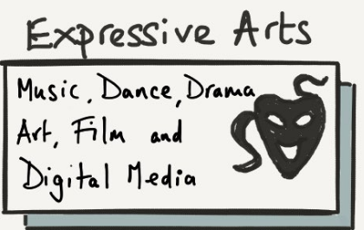
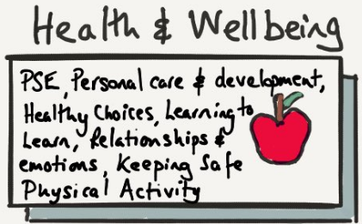
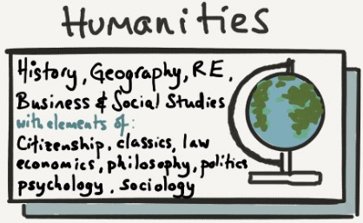
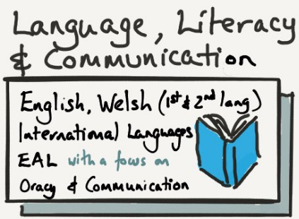
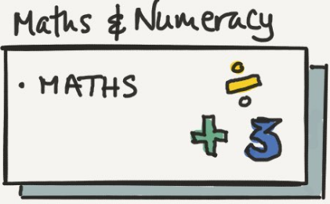
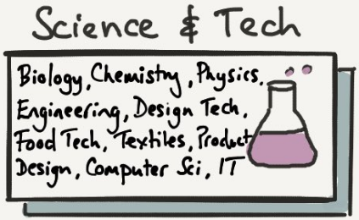
Areas of Learning Experience …
The Areas of Learning Experience connect to the Four Purposes, the shared vision and aspiration for every pupil at Gwenfro.
Our curriculum at Gwenfro features the Six Areas of Learning and Experience (AOLE’s), which are:
Expressive Arts; Health and Well-being; Humanities; Languages, Literacy and Communication; Mathematics and Numeracy; Science and Technology.
Experiences, knowledge and skills are developed through a learners journey from age 3 to 16 and is set out for each of the AOLE’s.
Each AOLE has an explanation of how it supports the Four Purposes in the form a ‘What Matters’ statement. This describes the key skills, knowledge and experience our pupils should learn and contributes to what we plan for our pupil at Gwenfro.
Staff at Gwenfro have worked to ensure a deepened understanding of the Statements of What Matters which will be used to map out our curriculum content as we move forward in planning for Curriculum for Wales.

Slide 18
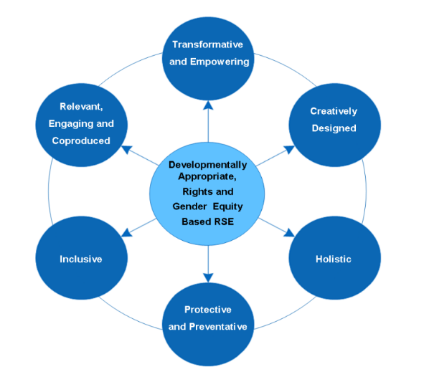
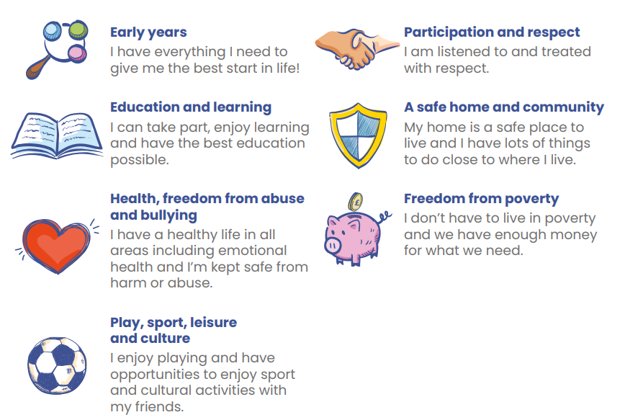
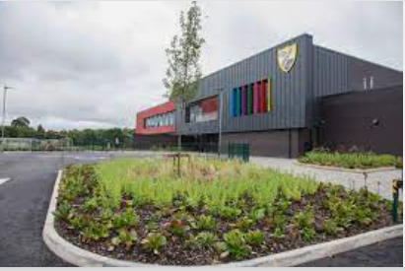
Cross Cutting Themes…
Cross Cutting Themes help to develop a broad and balanced curriculum
Cross-cutting themes are topics that are important and are integrated
within all learning. They help to enable our children to become Global learners.
The UNCRC is the United Nations Convention on the Rights of the Child. It is a list of rights for all children and young people, no matter who you are, where you live or what you believe in. They apply to children up to the age of 18.
The UNCRC lists 54 articles – rights that children and young people have to be safe, to play, to have an education, to be healthy, and be happy. All the rights in the UNCRC and are sorted into 7 different areas, called The Seven Core Aims.
Diversity is an awareness of the characteristics of others and treating others with compassion, empathy, understanding and equity, regardless of those characteristics.
This will enable pupils at Gwenfro to:
develop empathy and compassion for others
celebrate diverse backgrounds, values and characteristics
develop their own values and sense of identity
develop understanding of people with different beliefs and perspectives
challenge stereotypes
Learning about CWRE is fundamental to developing skills for work and life. This helps learners to understand the relationship between their learning and the world of work.
The curriculum at Gwenfro enables learners to gain experiences related to work and careers, developing knowledge of the breadth of opportunities available to them throughout their lives. This learning can help them make informed decisions about their career pathways.
Local, national and international contexts
The local, national and international contexts provide key perspectives for learner. They also introduce learners to less familiar contexts, broadening their horizons, engaging with perspectives different from their own and appreciating wider challenges and issues. These contexts also help them make sense of their relationship with their communities, their national identity and the wider world.

Slide 19
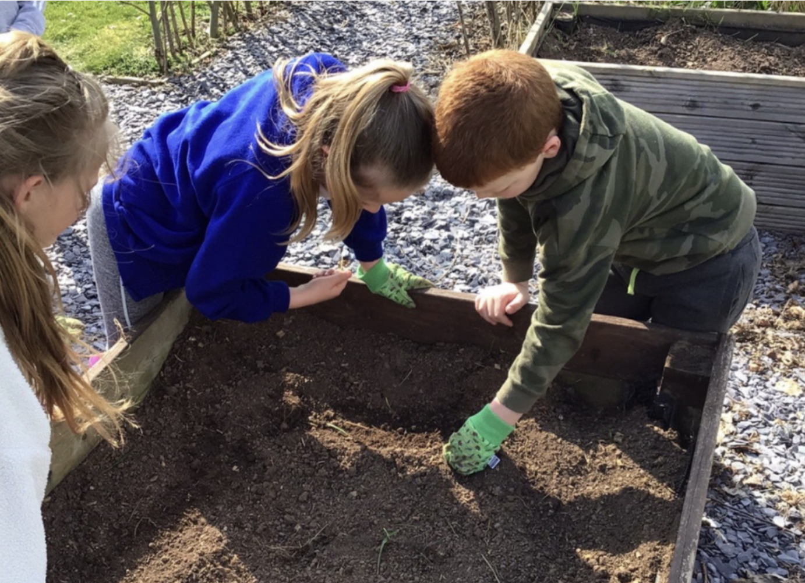
Well-Being….
Well-being is at the core of our vision and values at Gwenfro. We understand the importance of physical and mental well-being and the impact this has on pupils’ development and progression into becoming life long learners and citizens of the world.
Well-being is explicitly planned for and provided for every pupil through a range of class based opportunities where we look at aspects such as bereavement, transition, mindfulness and citizenship.
During these sessions we aim to teach our pupils to identify and recognise their emotions and develop strategies to manage their physical and mental well-being. We actively encourage our pupils to use their well-being learning power; Well-Being W’Kabi.
Our ethos and approach at Gwenfro is of nurture and support. We strive to develop positive working relationships and we pride ourselves on knowing our pupils and families well. We always aim to support well-being and offer a range of provision:
Counselling
Lego Club
Music Therapy
Equine Therapy
Draw to Talk
SAP
Unearthing
Alex Kelly
We are a My Happy Mind school. We aim to create a culture of positive mental well-being through the My Happy Mind curriculum.
At Gwenfro, we have a Family Engagement Officer who is on hand to provide guidance and support for parents/carers with a range of issues.
At Gwenfro, we always aim to provide opportunities to support parents/carers with their own physical and mental well-being, with the broader aim that this will impact positively on our pupils. This can be in the form of workshops, support videos, signposting to various agencies, Parents Group etc.
Gwenfro is an accredited Healthy School; and we actively encourage and support healthy lifestyles.

Slide 20
Collaboration….
At the heart of our self improving approach to improvement is collaboration with……
Gwenfro is part of the Clywedog ‘cluster’ of schools.
We are a group of primary schools and feeder secondary school who commit to:
Sharing information
Sharing effective practise
Planning for local and national reforms and priorities
Peer evaluation to support in our school improvement journeys
Transition of information, strategies and approaches
GWE are our regional school improvement consortia.
GWE supports Gwenfro to become a successful learning organisation to help all of our pupils succeed. A professional offer is shared with us and development opportunities are accessed to support improving standards of teaching and learning at Gwenfro.
Wrexham Local Authority ensures sufficient school places, oversees our admissions process, and ensures that our pupils with Additional Learning Needs or Disabilities have access to appropriate quality provision.
Gwenfro is a learning organisation and we work collaboratively within our school to develop new ideas and share effective practise.
We also work with cluster schools on shared priorities, focussing on effective practise and working collaboratively on local and national priorities.
We communicate with parents/carers via seesaw. We share the learning experiences of our pupils, key information and progress. This platform is also use to support home learning experiences.

Slide 21
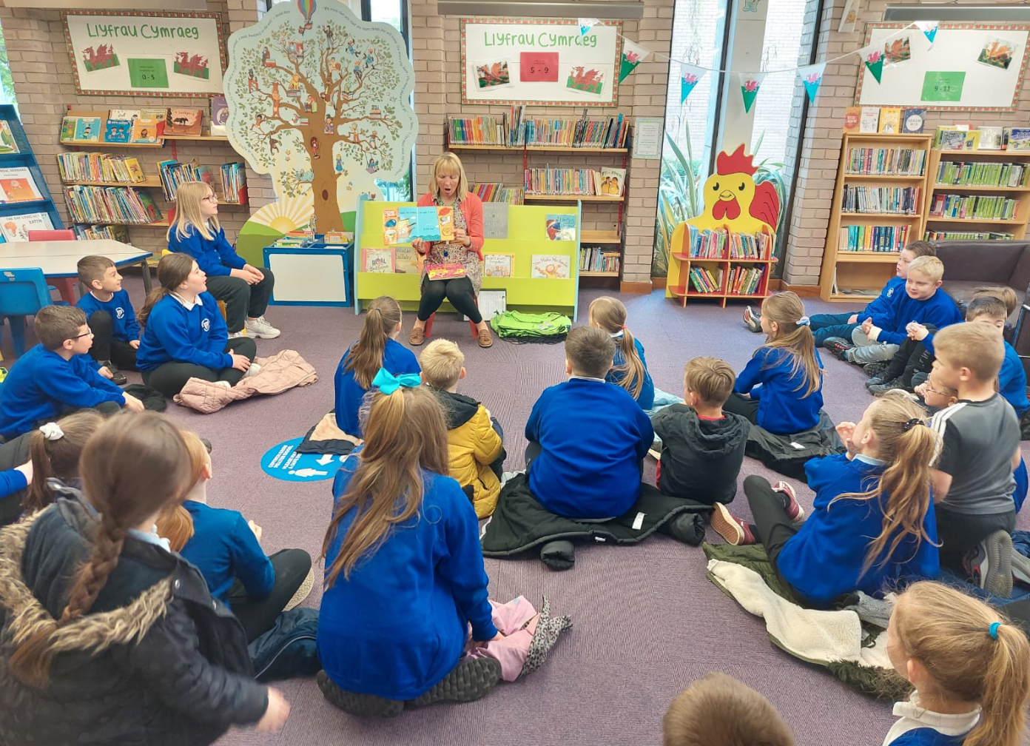
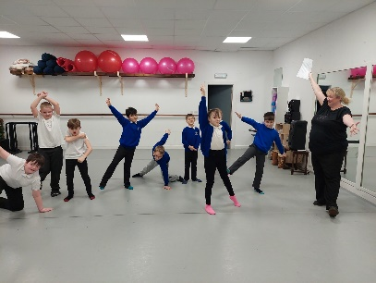
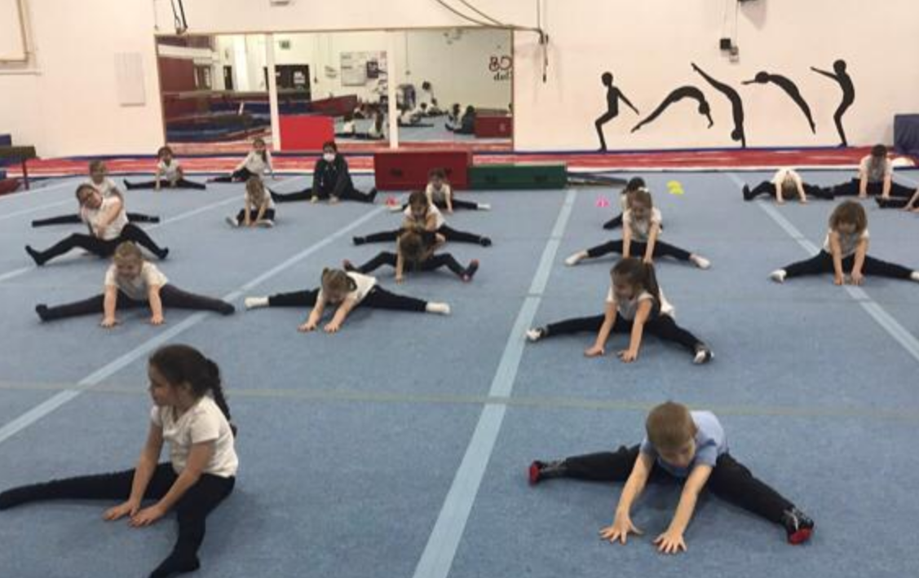
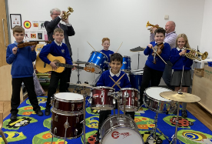
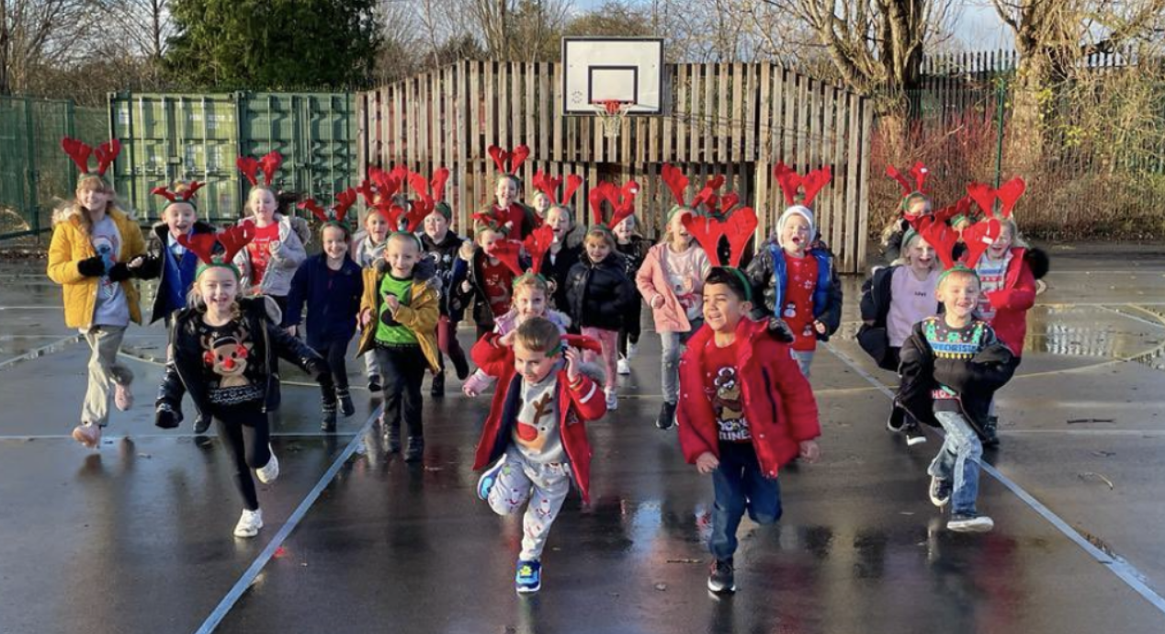
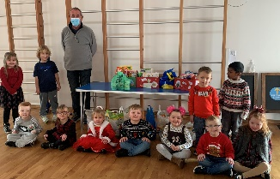
Community Links….
At Gwenfro, we value the importance of developing strong links between school and local, national and international communities.
Gwenfro is a community school and we work closely with local groups such as
Caia Park Partnership,
Caia Park Environmental Group and Caia Park Health Team. This supports our curriculum development as well as developing a sense of citizenship for our local area.
Wrexham itself and Caia Park in particular has a wealth of resources which have links with, with the broader aim of enhancing learning opportunities for our pupils.
We work with North Wales Police, Tesco, Venture, visit Wrexham Library, Queensway Gym, and Delta School of Performing Arts. We also make links with Active Wrexham who provide sport and well-being sessions for our pupils.
We are members of Wrexham Music Cooperative and use our PDG funding to ensure high quality music lessons for pupils.
We ensure that pupils develop a sense of responsibility and citizenship through links with local and national charities; Wrexham Foodbank, Nightingale House, GOSH, Children in Need etc
Through visits, gwasanathau and special events, we aim to involve our pupils in the local community to encourage our pupils to become active citizens of their community and to develop a sense of their own Cynefin.

Slide 22
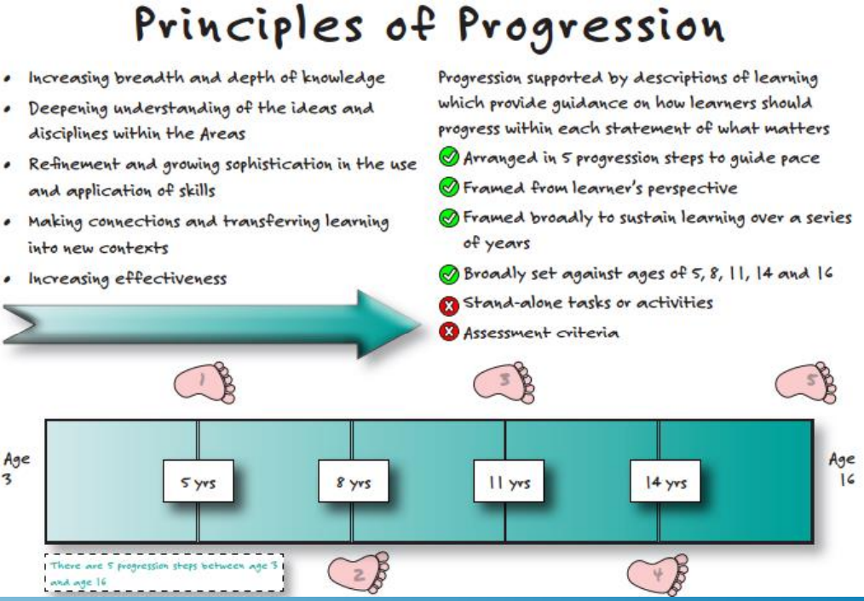
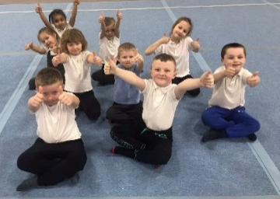
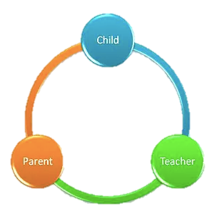
Assessment….
Pupil Progress is a continuum of learning from 3 to 16 and is integral to Curriculum for Wales.
Our assessment and progress tracking procedures are developing following a sustained period of action research about curriculum reform and pupil progress. Continued professional discussion and a shared understanding of progression is fundamental to improvement and our approach at Gwenfro.
Pupils at Gwenfro are on a journey from the first day they are with us and when they leave us, our processes will enable us to support effective transition throughout a child’s learning journey.
Learners are at the heart of our developing processes when reflecting and setting new goals.
Their response to feedback helps to create next steps.
Professional development opportunities (e.g. Shirley Clarke training, regional and local networking) help to ensure that assessment supports individual learners on an ongoing day to day basis.
Communicating & Engaging with parents/carers
We aim to keep parents/carers involved in learning and maximise engagement as an ongoing process through a blend of accessible reporting procedures. Reporting procedures are purposeful and meaningful with the aim of supporting pupil progression.
Working in partnership with Tyfu is enabling us to develop digital portfolios which will help practitioners and pupils to identify, capture and reflect on individual learner progress and reflect on next steps,

